Slide 1

Sustainable Development at the University of Cambridge.
Stewart Bethell
University of Cambridge
Greg Callaghan
Stantec

Slide 2
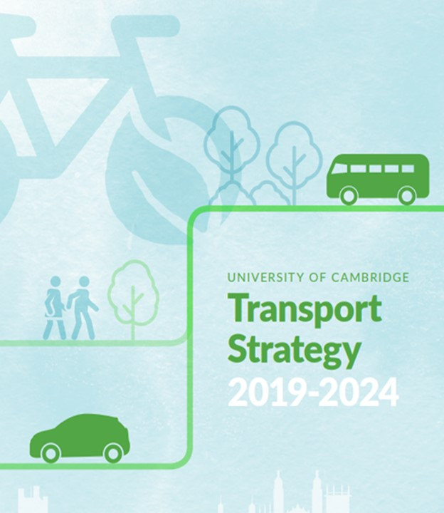
Facilitate convenient and predictable travel to the University sites and between University sites for all staff, students and visitors.
Minimise the University’s environmental footprint from transport and improve air quality in Cambridge.
Make a positive contribution to the wellbeing of staff and students and the quality of place, protecting and enhancing Cambridge’s historic and attractive environment.
Contribute to the development of the University estate and working practices in the University to reduce transport demand and reliance on motorised modes.
Exploit emerging and future technologies effectively and make best use of world class research within the University.

Slide 3
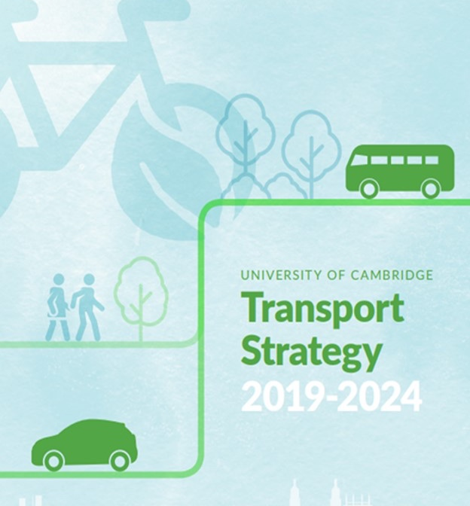
Target: 75% of staff members should regularly commute to work by sustainable modes of travel (walking, cycling, bus, train, motorcycle, car sharing or working at home (i.e. not in a single occupancy car).
It is monitored via an annual staff travel survey.

Slide 4
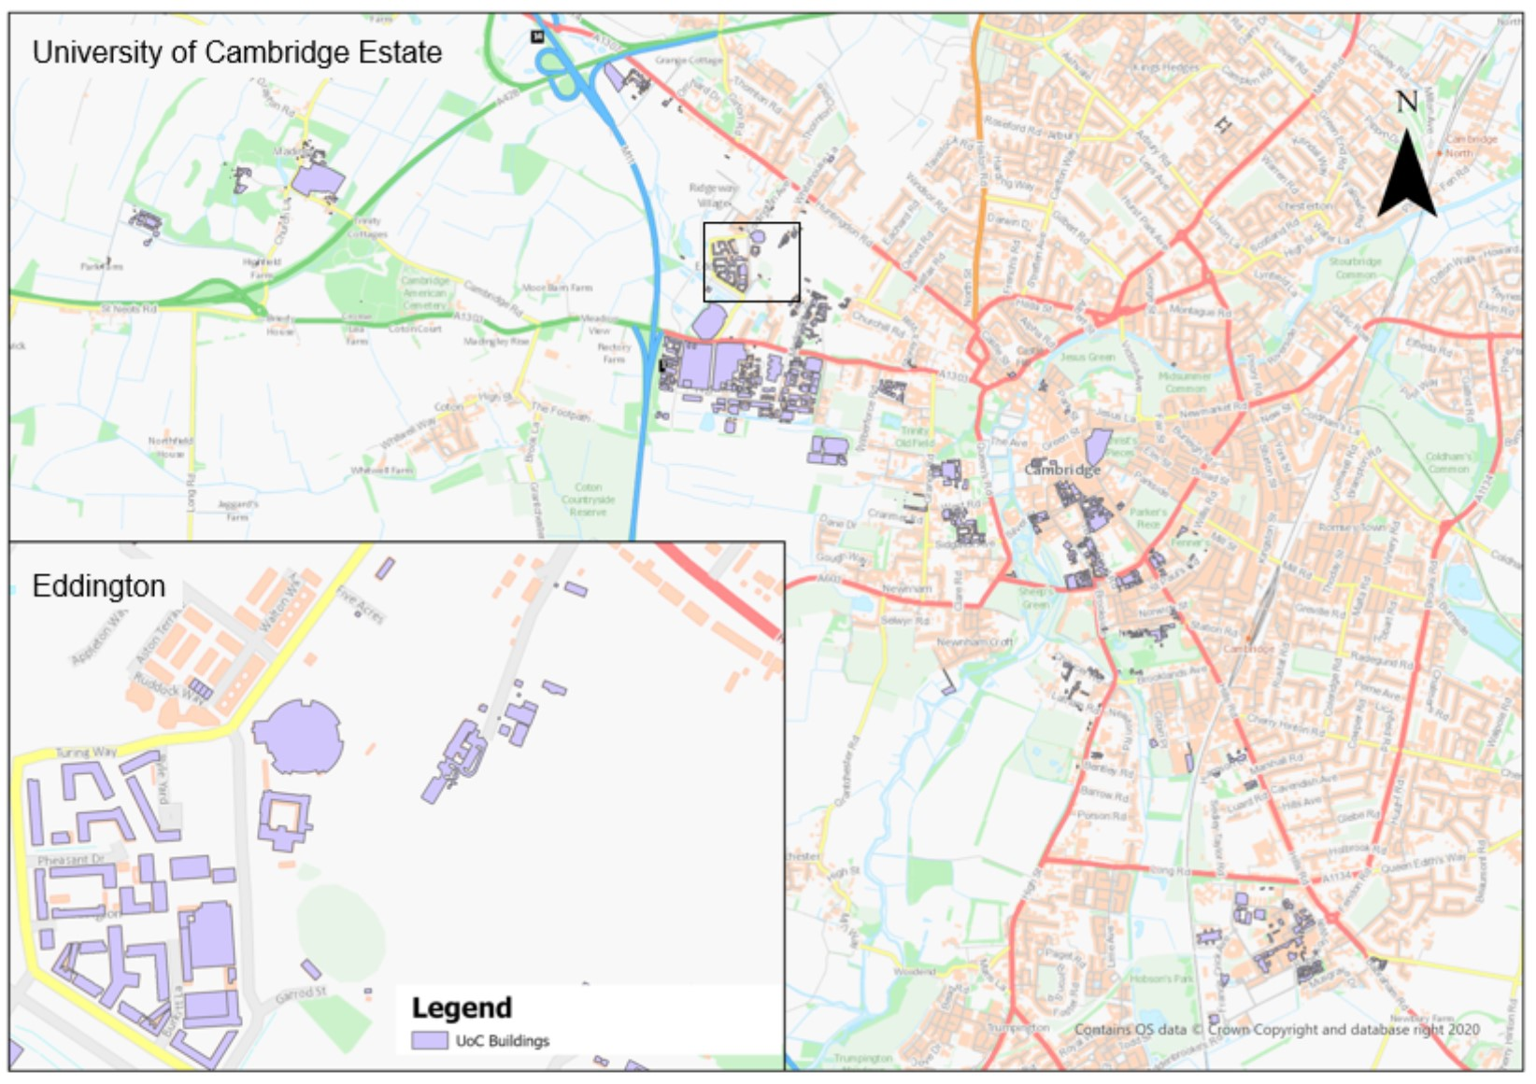
University of Cambridge
Buildings

Slide 5
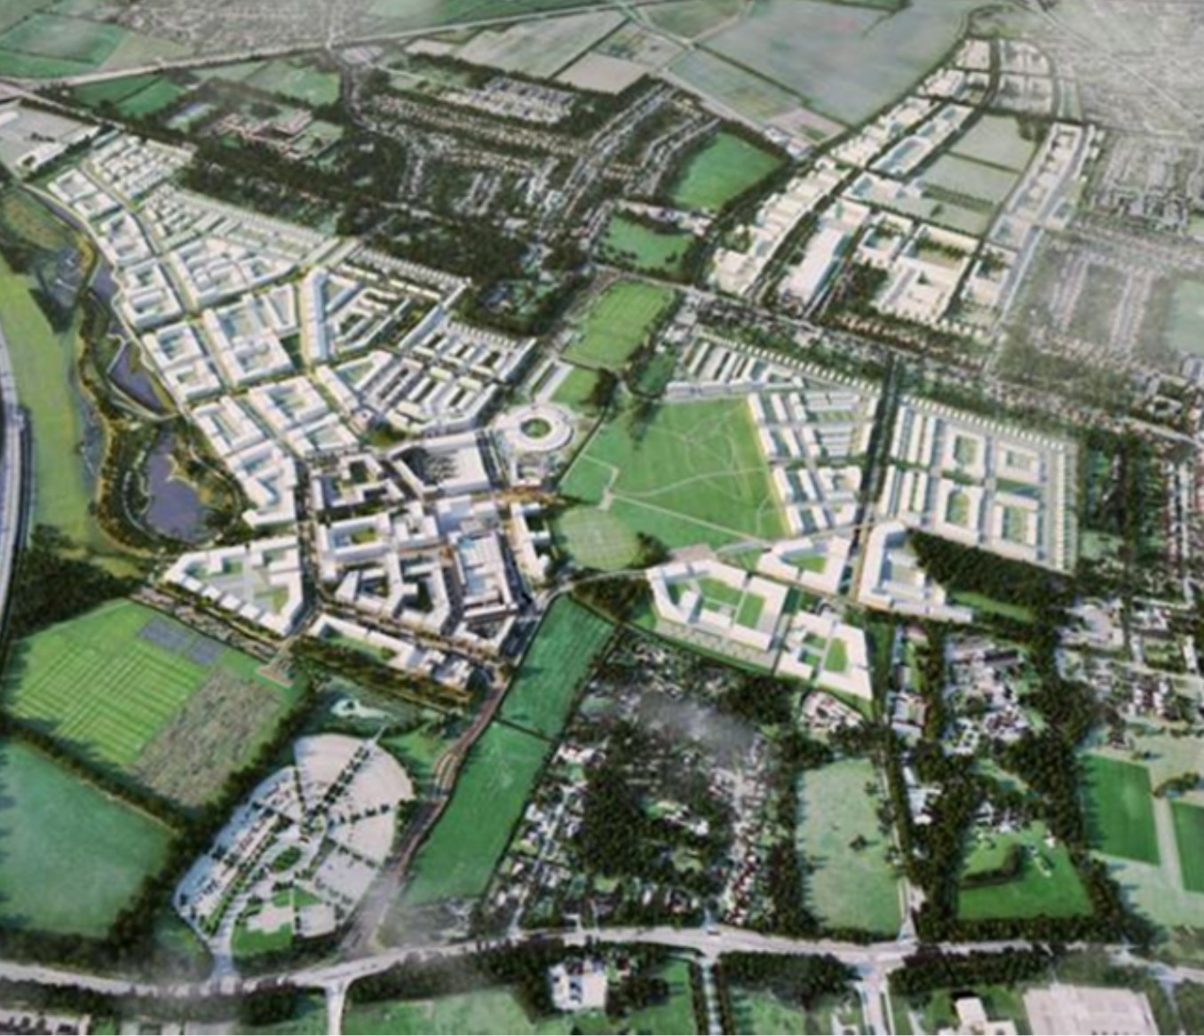
Applying a vision:
20-minute community Eddington, Cambridge

Slide 6
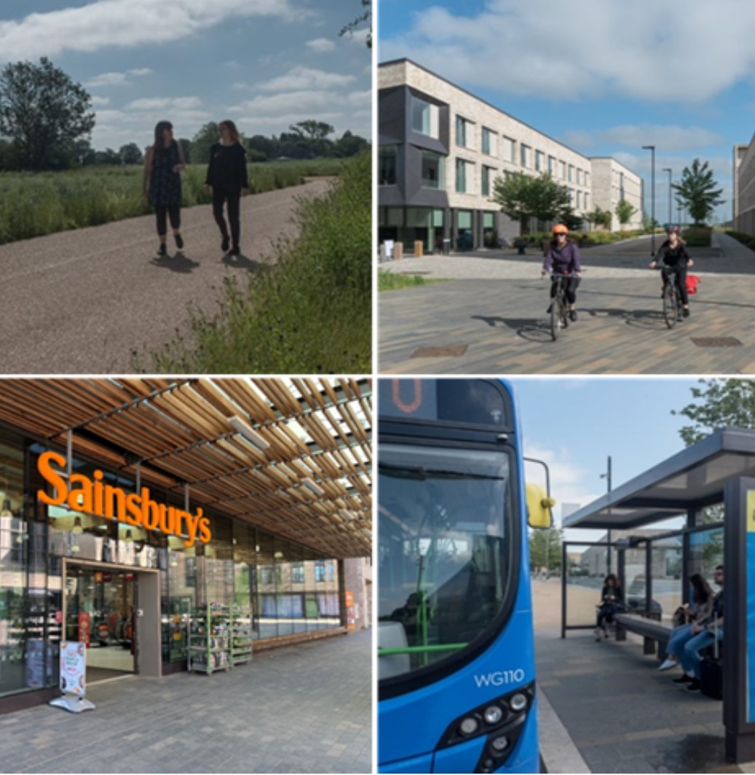
A new urban quarter for Cambridge, promoted, developed, and operated by UoC
Edge of City near the M11 and A14 and with relatively poor sustainable travel options at the outset
The development has created trips originating from dwellings to various University operational sites including central Cambridge and Cambridge Biomedical Campus Including social infrastructure including the school, Sainsbury’s, Hotel, and Storey’s Field community centre.

Slide 7
Proposed Development types
Land Use | Travel patterns differ to the typical as:
Market Housing | Whilst freely available on the open market, people generally do not live within Cambridge to work elsewhere – they’ve “brought in” to the local life style with reduced car usage
Market Flats
Key Worker Housing | Restricted / awarded to University Key Workers who work within the University’s facilities throughout Cambridge. Car parking de-coupled from housing, available only upon application, controlled by permit
Key Worker Flats
Collegiate Accommodation | Accommodation for post-grads only, subject to the University’s Motor Proctor control
Commercial Research | UofC-related commercial research facilities having far lower car trip generation rates than equivalent commercial science park facilities
Academic Research | Academic research land uses within the Development having limited parking and a lower car-based trip generation than commercial research land uses
Various Ancillary Land Uses | Provided on site to reduce the need to travel for the basics of life

Slide 8
Planning Data Requirements
The TRICS database is the best available and can provide trip generation estimate ranges for a variety of development scenarios.
However, because of the unique nature of the North-West Cambridge Development/Cambridge City setting, which is considered less conventional, a more bespoke approach has been required.
We agreed with CCC to use a “blended” approach to assessing person trips, generally using:
the TRICS database – to assess person trips for each land use; and
bespoke mode share data for each land use – to assign these total person trips by land use, to person trips by modes. National and local data sources used, with some commissioned surveys

Slide 9
Stantec Original Data Sources - 2010
Land Use | Trip Generation | Mode share
Market Housing | TRICS – All Sites | TRICS - Chesterton Cambridge survey
Market Flats | UofC - Cromwell Road survey (March 2005) | UofC - Cromwell Road survey (March 2005)
Key Worker Housing | UofC - Cromwell Road survey (March 2005) | TRICS / UofC Travel for Work survey (2009 TfW Survey Data for University of Cambridge)
Key Worker Flats | TRICS – All Sites | UofC Travel for Work survey (2009 TfW Survey Data for University of Cambridge)
Collegiate Accommodation | TRICS | Vehicle mode share – TRICS Non-car mode share – UofC Travel for Work survey(2009 TfW Survey Data for University of Cambridge)
Commercial Research | TRICS | Cambridge Science Park Travel for Work survey (2009 TfW Survey Data for Cambridge Science Park)
Academic Research | UofC - CAPE Building survey (April 2010) | UofC CAPE Building survey (April 2010)
School | TRICS | Off-peak hours – TRICS Peak hour - CCC’s Sustainable School Travel Strategy Annual Monitoring Report (11 May 2009)

Slide 10
Stantec – Transport Assessment – 2010
The Transport Assessment reported the following Total 12-hour Base Case Person Trip generation mode shares:

Slide 11
Transport Monitoring at Eddington
Cambridgeshire County Council Planning requirements:
Annual monitoring of through traffic
Car parking on neighbouring roads to the development
Trip Banking for A14 junction 31, not to exceed 200 trips above baseline
Deliver/Monitor sub-site travel plans
In addition to maintaining the UoC Transport Strategy Modal KPI of 75% or more of trips by sustainable mode.

Slide 12
University’s Transport Team (Manager + Coordinator)
Sainsbury’s
Travel Coordinator
Community Centre Travel Coordinator
Primary School Travel Coordinator & Parent Travel Committee
Hill & Other Developers
OPDA Travel Coordinator
Car Club operator (Enterprise)
Transport Stakeholders Group
Swirles Court (Girton College)
Bike Works CIC
Outspoken Cycles
Resident representatives
Bus Operators
(Whippet & Stagecoach)
Locke Hotel
Mears (operational maintenance)
Nursery
Travel Coordinator
Retailers

Slide 13
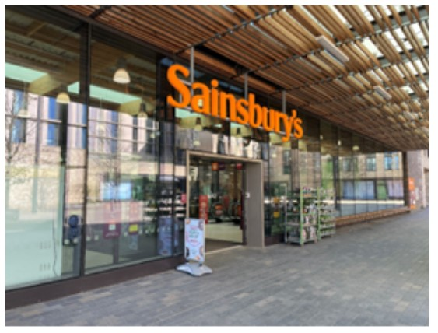
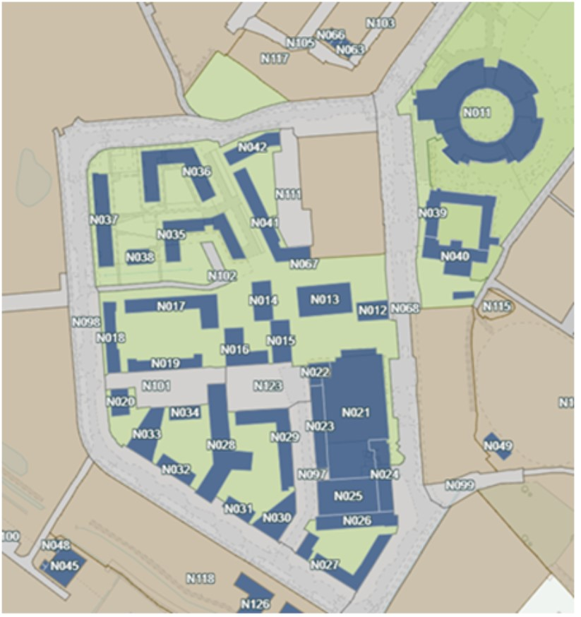
Store opening times:
Monday-Saturday 07:30 - 22:00hrs,
Sunday 10:00 - 16:00hrs
Total car parking spaces: (141)
Disabled: 8
Parent toddler: 5
Standard Car Parking: 128
Cycle Parking spaces: 50
Nearest Public Transport: 200 metres –
90 buses during the survey period (07:00 - 19:00hrs Mon-Fri).
Normal bus timetable:
Monday - Friday 06:00 - 23:00hrs
Saturday 07:00 - 23:00hrs and Sunday 07:00 - 20:00hrs
Sainsbury's Food Store -Eddington

Slide 14
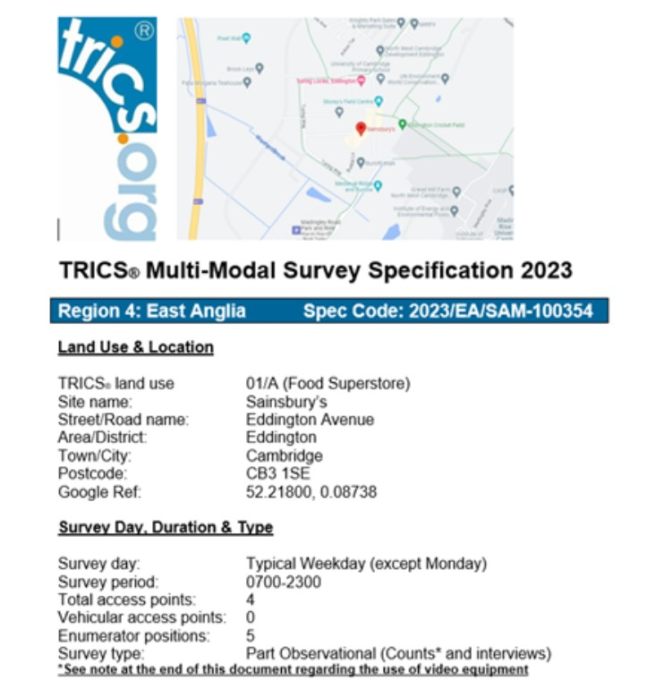
Reasoning and requirements of TRICS Monitoring
S106 Planning Condition compliance on trip generation
Support the annual Travel Plan monitoring
Exclude non-store trips from car park counts
Compare walking and cycling modes against the 2018 travel baseline
Utilise the data to inform phase two site master plan baseline.

Slide 15
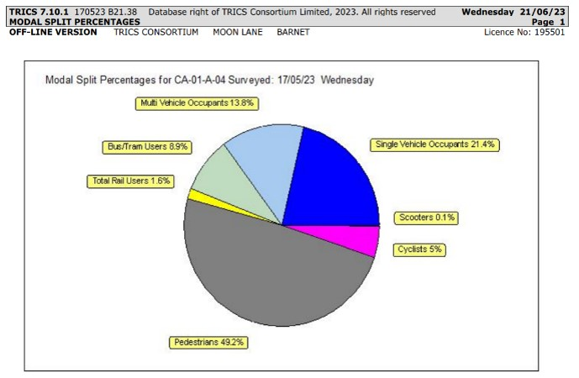
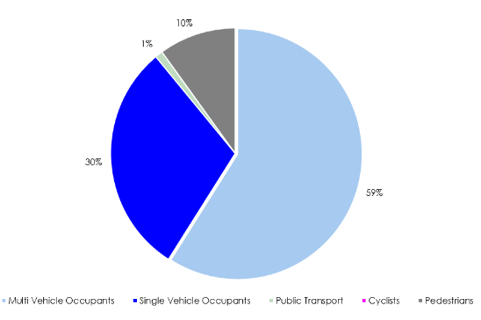
TRICS Comparison store data:
The Transport Assessment reported the following Total 12 hour Base Case Person Trip generation mode shares for the Food Store:
TA prediction (2010)
TRICS survey (TRICS – May 2023)

Slide 16
TRICS Comparison store data:
GFA range of 1,200m2 to 9,200m2.
All surveys from 01/01/2000 onwards.
Weekday only surveys (Monday-Friday (noting that most surveys were on Fridays)).
Location type to include: Edge of Town, Suburban Area, Neighbourhood Centre.
Sub-location types excluded: Retail Zone, Commercial Zone, Built-Up Zone, High Street.
All sites with a PFS included in the survey were excluded.
Highest population range within 1 mile is excluded (50,001-100,000).
Highest population range within 5 miles is excluded (500,001 or more).
SITE - REF | DESCRIPTION | TOWN/CITY | AREA | GFA | DAY | DATE
AR-01-A-01 | TESCO | DUNGANNON | ARMAGH | 2416 | FRI | 15/11/2002
CA-01-04 (EDDINGTON) | SAINSBURY'S | CAMBRIDGE | CAMBRIDGESHIRE | 3145 | WED | 17/05/2023
CP-01-A-01 | SAINSBURY'S | PONTLLANFRAITH | CAERPHILLY | 7124 | FRI | 07/10/2011
DC-01-A-13 | CO-OP PIONEER | BRIDPORT | DORSET | 1487 | FRI | 07/07/2000
DE-01-A-01 | SAINSBURY'S | LONDONDERRY | DERRY | 4042 | FRI | 15/11/2002
DV-01-A-21 | MORRISONS | PLYMOUTH | DEVON | 5000 | FRI | 23/10/2009
IA-01-A-01 | CO-OP | MENAI BRIDGE | ISLE OF ANGLESEY | 1825 | MON | 13/07/2009
LE-01-A-02 | ASDA | LEICESTER | LEICESTERSHIRE | 8900 | TUE | 23/06/2009
NM-01-A-03 | SAINSBURY'S | NORTHAMPTON | WEST NORTHAMPTONSHIRE | 7012 | FRI | 07/10/2011
SC-01-A-12 | SAINSBURY'S | WOKING | SURREY | 8250 | FRI | 23/11/2012
TW-01-A-02 | ASDA | NEWCASTLE UPON TYNE | TYNE & WEAR | 9050 | FRI | 03/05/2019
WN-01-A-10 | SAINSBURY'S | SLOUGH | WINDSOR & MAIDENHEAD | 6065 | FRI | 07/10/2011
WO-01-A-02 | WAITROSE | WORCESTER | WORCESTERSHIRE | 4780 | FRI | 27/09/2019
WS-01-A-10 | TESCO | CHICHESTER | WEST SUSSEX | 6003 | FRI | 21/07/2000

Slide 17
TRICS: Rank order for land use 01 - RETAIL/A - FOOD SUPERSTORE (Pedestrian Trip Rates per 100m2 GFA (Arrivals + Departures))
Time Range: 07:00-22:00

Slide 18
TRICS: Rank order for land use 01 - RETAIL/A - FOOD SUPERSTORE (Bus/Tram and Cyclist Trip Rates per 100m2 GFA (Arrivals + Departures)
Time Range: 07:00-22:00

Slide 19
TRICS: Rank order for land use 01 - RETAIL/A - FOOD SUPERSTORE (Total Vehicles and Vehicle Occupants Trip Rates per 100m2 GFA (Arrivals + Departures)) Time Range: 07:00-22:00

Slide 20
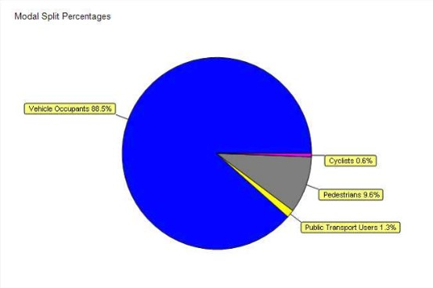
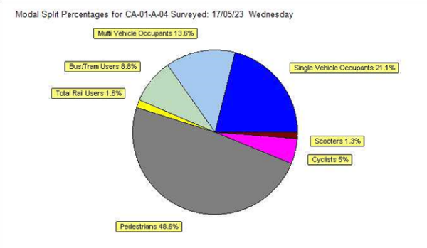
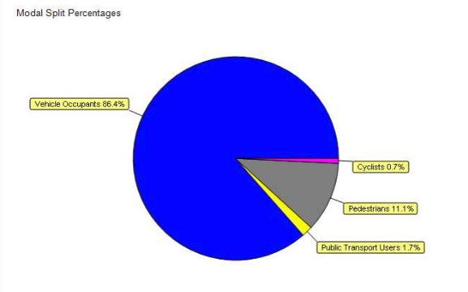
Eddington Full Modal Split
Comparison Sites Full Modal Split
Full Modal split Excluding Eddington
Full Modal split Including Eddington

Slide 21
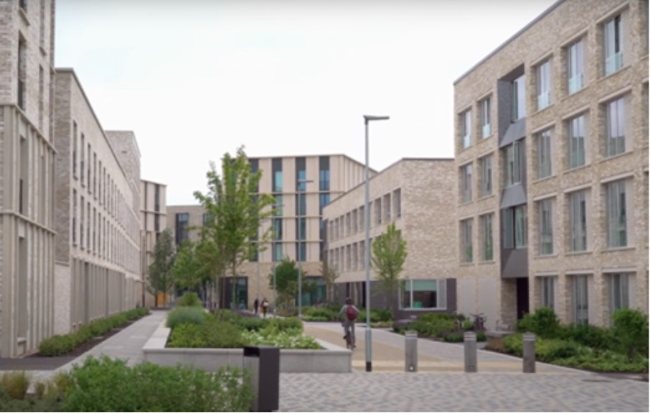
Reflections:
Eddington is demonstrating its phase one vision of being a sustainable development by:
Designing and building a community, where car ownership is not a requirement to live.
Delivery of social infrastructure within phase one of the development, i.e. Primary school, Nursery, Hairdressers, Bars, Restaurants, Hotel, Retail
Limited number of public on-street parking spaces and resident parking to discourage car ownership
The provision of walking and cycling routes to key onward destinations was key to the initial phase one
Where the public transport provision was achieved early and supports access to within 400Mtrs of most University sites/buildings
Continued support for on-site access to public hire E-mobility e-bikes /Scooters through Voi.

Slide 22
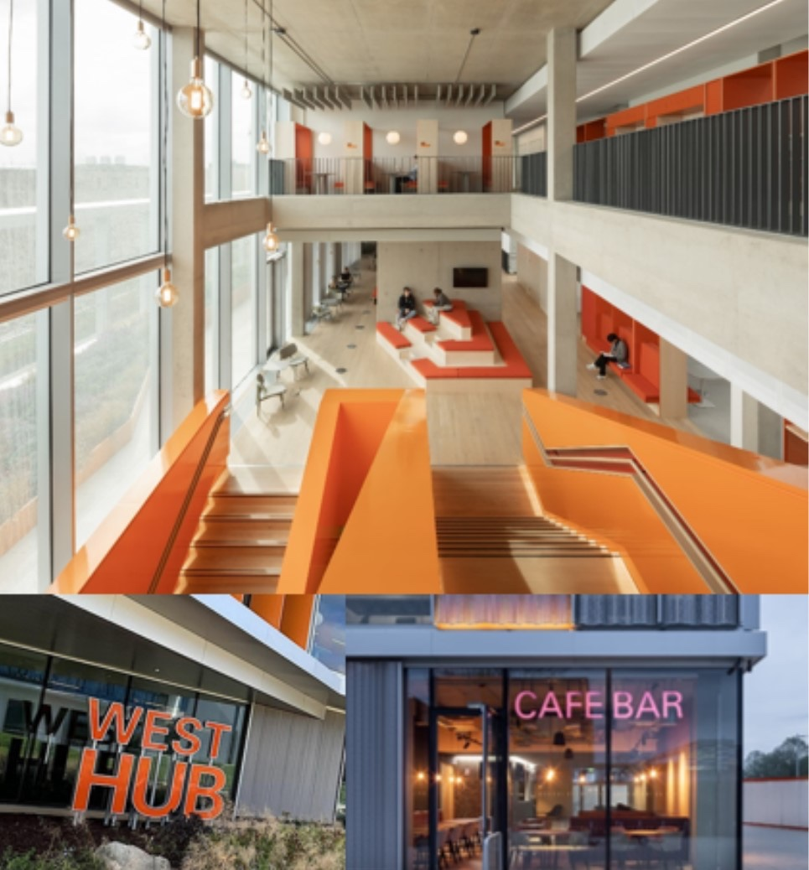
University of Cambridge
West Hub Monitoring - in progress
West Cambridge Innovation Development
Creation of Cambridge-centric Data. (Labs, Hubs, Etc) to support trip banking reporting.
Trip data-driven support for the “reshaping the estate” program, with independently validated trip data.

Slide 23
Thank you for your interest.
Eddington-cambridge.co.uk
Stewart Bethell
stewart.bethell@admin.cam.ac.uk
Greg Callaghan
greg.callaghan@stantec.com

